Slide 1
Azure Compute & Networking

Slide 2
Compute and Networking- Objective Domain
Describe the benefits and usage of:
Compare compute types, including container instances, virtual machines, and functions.
Describe virtual machine options, including virtual machines (VMs), virtual machine scale sets, virtual machine availability sets, and Azure Virtual Desktop.
Describe resources required for virtual machines.
Describe application hosting options, including Azure Web Apps, containers, and virtual machines.
Describe virtual networking, including the purpose of Azure Virtual Networks, Azure virtual subnets, peering, Azure DNS, VPN Gateway, and ExpressRoute.
Define public and private endpoints.
Notes:
https://docs.microsoft.com/learn/modules/describe-azure-compute-networking-services/1-introduction

Slide 3





Azure compute services
Azure compute is an on-demand computing service that provides computing resources such as disks, processors, memory, networking, and operating systems.
Virtual
Machines
App
Services
Container Instances
Azure Kubernetes Services (AKS)
Azure Virtual Desktop
Notes:
https://azure.microsoft.com/products/category/compute/

Slide 4
Azure virtual machines
Azure Virtual Machines (VM) are software emulations of physical computers.
Includes virtual processor, memory, storage, and networking.
IaaS offering that provides total control and customization.
© Copyright Microsoft Corporation. All rights reserved.
Notes:
https://docs.microsoft.com/learn/modules/describe-azure-compute-networking-services/2-virtual-machines
Development and test – Azure VMs offer a quick and easy way to create a computer with specific configurations required to code and test an application.
Applications in the cloud – Because demand for your application can fluctuate, it might make economic sense to run it on a VM in Azure. You pay for extra VMs when you need them and shut them down when you don’t.
Extended datacenter – Virtual machines in an Azure virtual network can easily be connected to your organization’s network.
Azure virtual machines - https://azure.microsoft.com/en-us/services/virtual-machines/

Slide 5
Determine Virtual Machine Sizing
Type | Description
General purpose | Balanced CPU-to-memory ratio.
Compute optimized | High CPU-to-memory ratio.
Memory optimized | High memory-to-CPU ratio.
Storage optimized | High disk throughput and I/O.
GPU | Specialized virtual machines targeted for heavy graphic rendering and video editing..
High performance compute | Our fastest and most powerful CPU virtual machines
✔️ Share VM images in a compute gallery

Slide 6
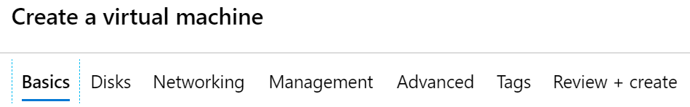
Create Virtual Machines in the Portal
Basic (required) – Project details, Administrator account, Inbound port rules
Disks – OS disk type, data disks
Networking – Virtual networks, load balancing
Management – Monitoring, Auto-shutdown, Backup
Advanced – Add additional configuration, agents, scripts or applications

Slide 7

VM scale sets
Scale sets provide a load-balanced opportunity to automatically scale resources.
Scale out when resource needs increase.
Scale in when resource needs are lower.
© Copyright Microsoft Corporation. All rights reserved.
Notes:
https://docs.microsoft.com/learn/modules/describe-azure-compute-networking-services/2-virtual-machines

Slide 8
Compare Vertical to Horizontal Scaling
Vertical scaling (scale up and scale down) is the process of increasing or decreasing power to a single instance of a workload; usually manual​
Horizontal scaling (scale out and scale in) is the process of increasing or decreasing the number of instances of a workload; frequently automated
Virtual Machine Scale Sets (VMSS) ONLY deal with horizontal scaling of the virtual machines.

Slide 9
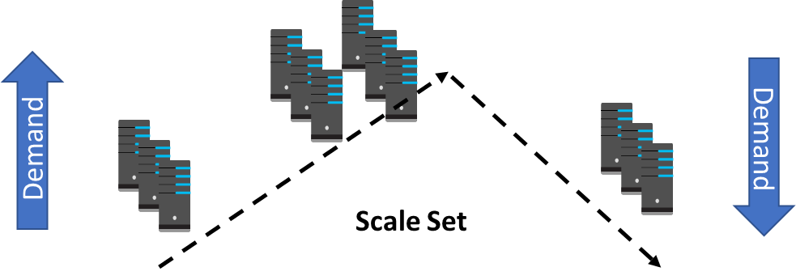
Implement Scale Sets
Scale sets deploy a set of identical VMs
No pre-provisioning of VMs is required
As demand goes up VMs are added
As demand goes down VM are removed
The process can be manual, automated, or a combination of both

Slide 10
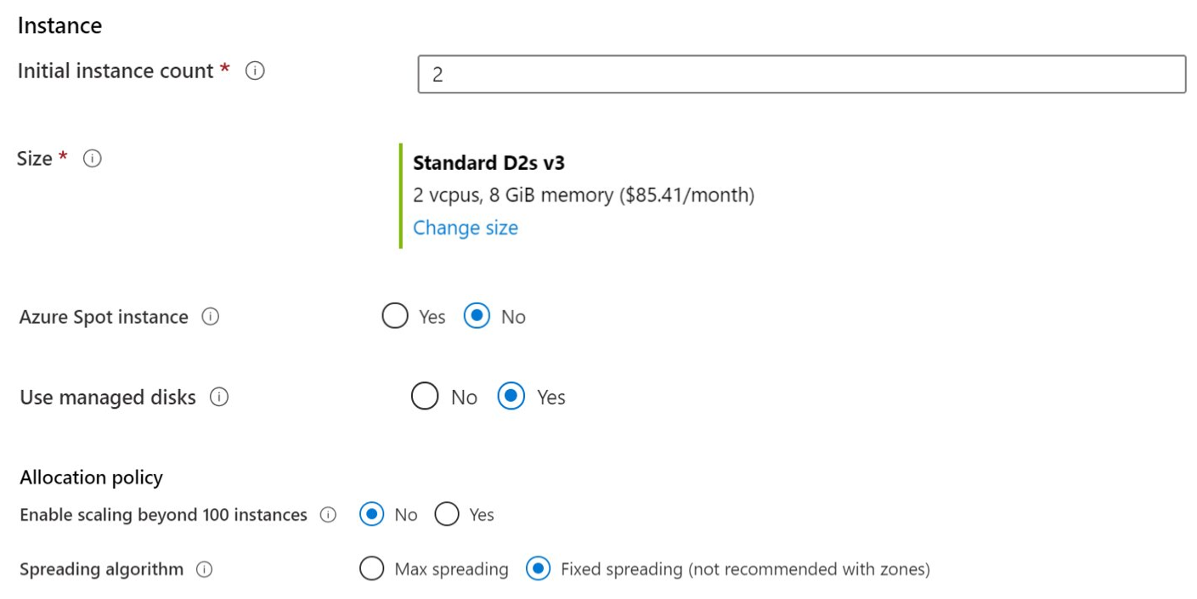
Create Scale Sets
Instance count. Number of VMs in the scale set (0 to 1000)
Instance size. The size of each virtual machine in the scale set
Azure Spot Instance. Unused capacity at a discounted rate
Use managed disks
Enable scaling beyond 100 instances

Slide 11
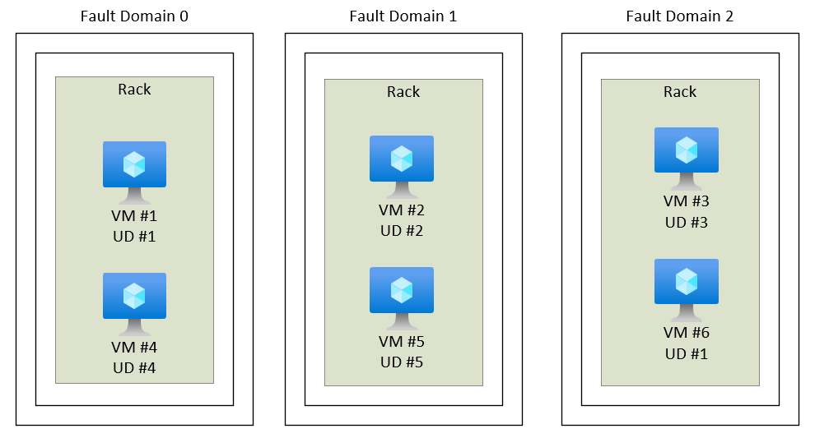
VM availability sets
© Copyright Microsoft Corporation. All rights reserved.
Notes:
https://docs.microsoft.com/learn/modules/describe-azure-compute-networking-services/2-virtual-machines
Update domain keeps VMs grouped if they can be rebooted at the same time without causing an outage.
Fault domains group VMs based on common power and networking.

Slide 12
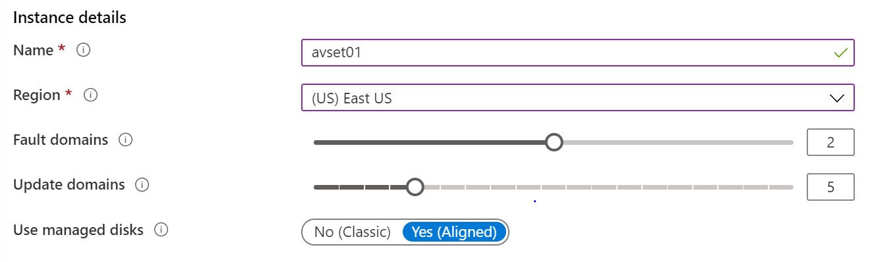
Setup Availability Sets
Two or more instances in Availability Sets = 99.95% SLA
Configure multiple Virtual Machines in an Availability Set
Configure each application tier into separate Availability Sets
Combine a Load Balancer with Availability Sets
Use managed disks with the Virtual Machines

Slide 13
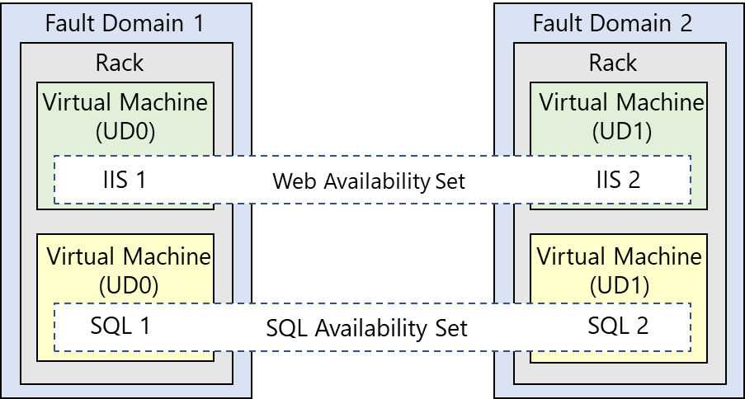
Review Update and Fault Domains
Update domains allows Azure to perform incremental or rolling upgrades across a deployment. During planned maintenance, only one update domain is rebooted at a time
Fault Domains are a group of Virtual Machines that share a common set of hardware, switches, that share a single point of failure. VMs in an availability set are placed in at least two fault domains
Notes:
Fault domain
Prevent Hardware failures like limit the impact of potential physical hardware failures, network outages, or power interruptions
1 Rack that share common power source and network switch.
Max- 3 FD per availability set, Default value=2
Update domain
Max= 20 UD, Default=5
Update domains indicate groups of virtual machines and underlying physical hardware that can be rebooted at the same time
The order of update domains being rebooted may not proceed sequentially during planned maintenance, but only one update domain is rebooted at a time. A rebooted update domain is given 30 minutes to recover before maintenance is initiated on a different update domain.

Slide 14
VM Creation - Planning Checklist
Start with the network
Understand the pricing model
Name the VM
Consider storage for the VM
Decide the location for the VM
Select an operating system
Determine the size of the VM

Slide 15
Azure Virtual Desktop
Azure Virtual Desktop is a desktop and app virtualization that runs in the cloud.
Create a full desktop virtualization environment without having to run additional gateway servers.
Reduce risk of resource being left behind.
True multi-session deployments.
© Copyright Microsoft Corporation. All rights reserved.
Notes:
https://docs.microsoft.com/learn/modules/describe-azure-compute-networking-services/4-virtual-desktop
https://docs.microsoft.com/en-us/azure/virtual-desktop/overview

Slide 16
Azure Container Services
Azure Containers are a light-weight, virtualized environment that does not require operating system management, and can respond to changes on demand.
Azure Container Instances: a PaaS offering that runs a single container in Azure without the need to manage a virtual machine or additional services.
Azure Kubernetes Service: an orchestration service for containers with distributed architectures and large volumes of containers.
© Copyright Microsoft Corporation. All rights reserved.
Notes:
https://docs.microsoft.com/learn/modules/describe-azure-compute-networking-services/5-containers
Containers are a virtualization environment. However, unlike virtual machines, you do not manage an operating system. Containers are meant to be lightweight, and are designed to be created, scaled out, and stopped dynamically.
Azure Container Instances - https://azure.microsoft.com/en-us/services/container-instances/
Azure Kubernetes Service - https://azure.microsoft.com/en-us/services/kubernetes-service/

Slide 17


Azure Functions
Azure Functions is an event-driven, serverless compute option that doesn’t require maintaining virtual machines or containers.
If you build an app using VMs or containers, those resources have to be “running” for your app to function.
With Azure Functions, an event wakes the function, alleviating the need to keep resources provisioned when there are no events.
Functions are commonly used when you need to perform work in response to an event (often via an HTTP request), timer, or message from another Azure service, and when that work can be completed quickly, within seconds or less.
Azure Functions
Event based code running your service and not the underlying infrastructure.
Notes:
https://docs.microsoft.com/learn/modules/describe-azure-compute-networking-services/6-functions
Serverless computing is the evolution of cloud platforms in the direction of pure cloud native code. Serverless brings developers closer to business logic while insulating them from infrastructure concerns. It's a pattern that doesn't imply "no server" but rather, "less server." Serverless code is event-driven. Code may be triggered by anything from a traditional HTTP web request to a timer or the result of uploading a file. The infrastructure behind serverless allows for instant scale to meet elastic demands and offers micro-billing to truly "pay for what you use." Serverless requires a new way of thinking and approach to building applications and isn't the right solution for every problem.
Azure Functions is code running your service and not the underlying platform or infrastructure. Creates infrastructure based on an event.
Azure Functions - https://docs.microsoft.com/en-us/azure/azure-functions/
Note: For more details about serverless services available with Azure, see https://azure.microsoft.com/en-us/solutions/serverless/

Slide 18
Azure Functions – Common Scenarios
The following are a common, but by no means exhaustive, set of scenarios for Azure Functions.
If you want to... | then...
Build a web API | Implement an endpoint for your web applications using the HTTP trigger
Process file uploads | Run code when a file is uploaded or changed in blob storage
Build a serverless workflow | Create an event-driven workflow from a series of functions using durable functions
Respond to database changes | Run custom logic when a document is created or updated in Azure Cosmos DB
Run scheduled tasks | Execute code on pre-defined timed intervals
Create reliable message queue systems | Process message queues using Queue Storage, Service Bus, or Event Hubs
Analyze IoT data streams | Collect and process data from IoT devices
Process data in real time | Use Functions and SignalR to respond to data in the moment
Notes:
https://learn.microsoft.com/en-us/azure/azure-functions/functions-overview

Slide 19
Comparing Azure compute options
Virtual machines
Virtual Desktop
Containers
Cloud based server that supports either Windows or Linux environments.
Provides a cloud based personal computer Windows desktop experience.
Lightweight, miniature environment well suited for running microservices.
Useful for lift-and-shift migrations to the cloud.
Dedicated applications to connect and use, or accessible from any modern browser.
Designed for scalability and resiliency through orchestration.
Complete operating system package, including the host operating system.
Multi-client login allows multiple users to log into the same machine at the same time.
Applications and services are packaged in a container that sits on-top of the host operating system. Multiple containers can sit on one host OS.

Slide 20
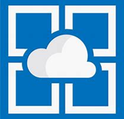
Azure App Services
Azure App Services is a fully managed platform to build, deploy, and scale web apps and APIs quickly.
Works with .NET, .NET Core, Node.js, Java, Python, or php.
PaaS offering with enterprise-grade performance, security, and compliance requirements.
© Copyright Microsoft Corporation. All rights reserved.
Notes:
https://docs.microsoft.com/learn/modules/describe-azure-compute-networking-services/7-describe-application-hosting-options

Slide 21
App Services – Uses & Benefits
With App Service, you can host most common app service styles like:
Web apps
API apps
WebJobs
Mobile apps
App Service handles most of the infrastructure decisions you deal with in hosting web-accessible apps:
Deployment and management are integrated into the platform.
Endpoints can be secured.
Sites can be scaled quickly to handle high traffic loads.
The built-in load balancing and traffic manager provide high availability.
Notes:
Web apps
App Service includes full support for hosting web apps by using ASP.NET, ASP.NET Core, Java, Ruby, Node.js, PHP, or Python. You can choose either Windows or Linux as the host operating system.
API apps
Much like hosting a website, you can build REST-based web APIs by using your choice of language and framework. You get full Swagger support and the ability to package and publish your API in Azure Marketplace. The produced apps can be consumed from any HTTP- or HTTPS-based client.
WebJobs
You can use the WebJobs feature to run a program (.exe, Java, PHP, Python, or Node.js) or script (.cmd, .bat, PowerShell, or Bash) in the same context as a web app, API app, or mobile app. They can be scheduled or run by a trigger. WebJobs are often used to run background tasks as part of your application logic.
Mobile apps
Use the Mobile Apps feature of App Service to quickly build a back end for iOS and Android apps. With just a few actions in the Azure portal, you can:
Store mobile app data in a cloud-based SQL database.
Authenticate customers against common social providers, such as MSA, Google, Twitter, and Facebook.
Send push notifications.
Execute custom back-end logic in C# or Node.js.
On the mobile app side, there's SDK support for native iOS and Android, Xamarin, and React native apps.

Slide 22

Azure networking services
Azure Virtual Network (VNet) enables Azure resources to communicate with each other, the internet, and on-premises networks.
Public endpoints, accessible from anywhere on the internet
Private endpoints, accessible only from within your network
Virtual subnets, segment your network to suit your needs
Network peering, connect your private networks directly together
Notes:
https://docs.microsoft.com/learn/modules/describe-azure-compute-networking-services/8-virtual-networking

Slide 23
Virtual Networks – Planning & Designing
Virtual Network
Subnet
On-premises
NIC
NIC
Virtual Network(s)
Virtual Machines
Logical representation of your own network
Create a dedicated private cloud-only virtual network
Securely extend your datacenter with virtual networks
Enable hybrid cloud scenarios
Notes:
Azure Virtual Networks - https://azure.microsoft.com/services/virtual-network/
What is Azure Virtual Network? - https://docs.microsoft.com/azure/virtual-network/virtual-networks-overview

Slide 24
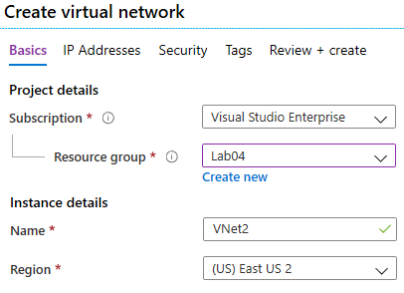
Create Virtual Networks
Create new virtual networks at any time
Add virtual networks when you create a virtual machine
Need to define the address space, and at least one subnet
Be careful with overlapping address spaces
Notes:
QuickStart: Create a virtual network using the Azure portal - https://docs.microsoft.com/azure/virtual-network/quick-create-portal
✔️ Always plan to use an address space that is not already in use in your organization, either on-premises or in other VNets. Even if you plan for a VNet to be cloud-only, you may want to make a VPN connection to it later. If there is any overlap in address spaces at that point, you will have to reconfigure or recreate the VNet. The next lesson will focus on IP addressing.

Slide 25
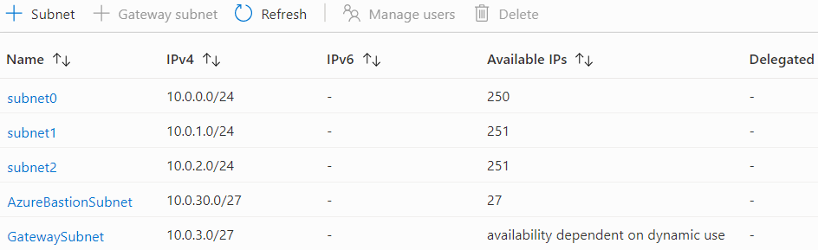
Create Subnets
A virtual network can be segmented into one or more subnets
Subnets provide logical divisions within your network
Subnets can help improve security, increase performance, and make it easier to manage the network
Each subnet must have a unique address range – cannot overlap with other subnets in the vnet in the subscription
Notes:
✔️ Azure reserves 5 IP addresses within each subnet.
x.x.x.0: Network address
x.x.x.1: Reserved by Azure for the default gateway
x.x.x.2, x.x.x.3: Reserved by Azure to map the Azure DNS IPs to the VNet space
x.x.x.255: Network broadcast address

Slide 26

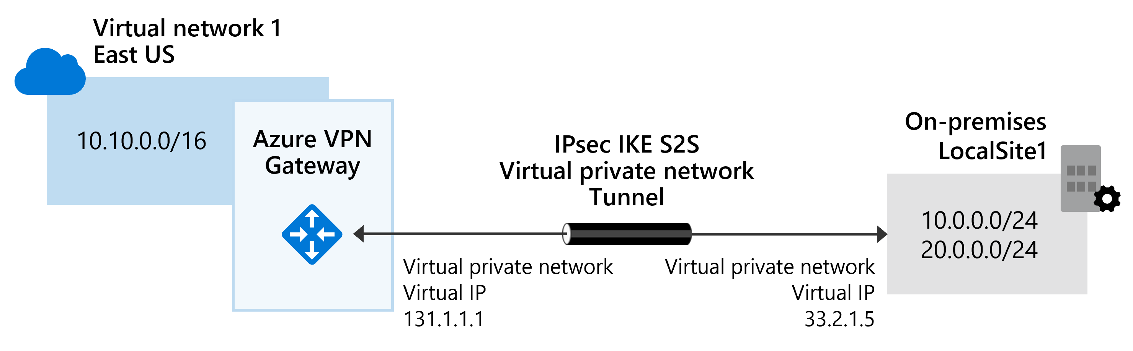
Azure networking services
Virtual Private Network Gateway (VPN) is used to send encrypted traffic between an Azure virtual network and an on-premises location over the public internet.
Notes:
https://docs.microsoft.com/learn/modules/describe-azure-compute-networking-services/10-virtual-private-networks
Azure VPN Gateway is a service that uses a specific type of virtual network gateway to send encrypted traffic between an Azure virtual network and on-premises locations over the public Internet, or between two Azure Virtual Networks.
After you create a VPN gateway, you can configure connections.
For example, you can create an [IPsec/IKE] VPN tunnel connection between that VPN gateway and another VPN gateway (VNet-to-VNet), or
Create a cross-premises [IPsec/IKE] VPN tunnel connection between the VPN gateway and an on-premises VPN device (Site-to-Site).
Optional
IPSEC/IKE v1
Understand IPsec IKEv1 Protocol - Cisco

Slide 27

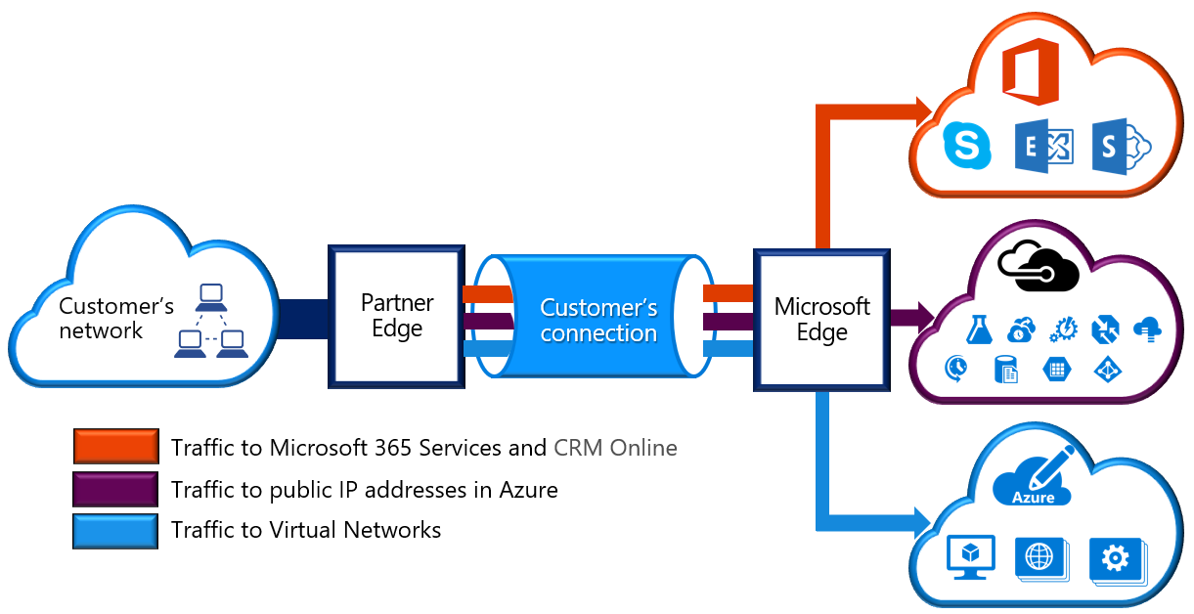
Azure networking services
Azure Express Route extends on-premises networks into Azure over a private connection that is facilitated by a connectivity provider.
Notes:
https://docs.microsoft.com/learn/modules/describe-azure-compute-networking-services/11-expressroute/

Slide 28
ExpressRoute – Features and Benefits
ExpressRoute enables direct access to the following services in all regions:
Microsoft Office 365
Microsoft Dynamics 365
Azure compute services, such as Azure Virtual Machines
Azure cloud services, such as Azure Cosmos DB and Azure Storage

Slide 29
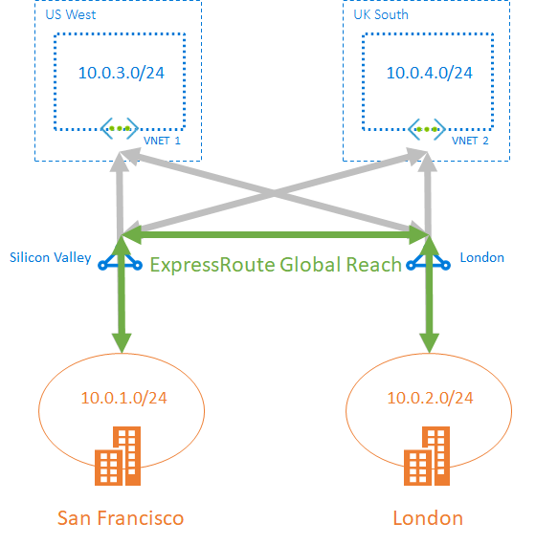
ExpressRoute – Global Reach
You can enable ExpressRoute Global Reach to exchange data across your on-premises sites through Microsoft Network by connecting your ExpressRoute circuits.
For example, assume you have an office in Asia and a datacenter in Europe, both with ExpressRoute circuits connecting them to the Microsoft network.
You could use ExpressRoute Global Reach to connect those two facilities, allowing them to communicate without transferring data over the public internet.
With ExpressRoute Global Reach, you can link ExpressRoute circuits together to make a private network between your on-premises networks.
In our example to the right, with the addition of ExpressRoute Global Reach, your San Francisco office (10.0.1.0/24) can directly exchange data with your London office (10.0.2.0/24) through the existing ExpressRoute circuits and via Microsoft's global network.
Notes:
https://learn.microsoft.com/en-us/azure/expressroute/expressroute-global-reach

Slide 30

Azure DNS
Reliability and performance by leveraging a global network of DNS name servers using Anycast networking.
Azure DNS security is based on Azure resource manager, enabling role-based access control and monitoring and logging.
Ease of use for managing your Azure and external resources with a single DNS service.
Customizable virtual networks allow you to use private, fully customized domain names in your private virtual networks.
Alias records supports alias record sets to point directly to an Azure resource.
Notes:
https://docs.microsoft.com/learn/modules/describe-azure-compute-networking-services/12-domain-name-system

Slide 31
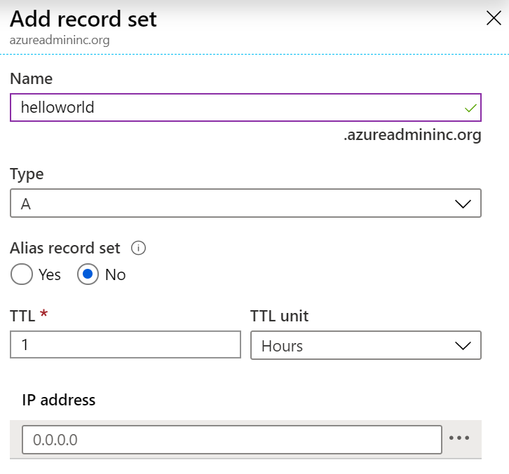
Add DNS Record Sets
A record set is a collection of records in a zone that have the same name and are the same type
You can add up to 20 records to any record set
A record set cannot contain two identical records
Changing the drop-down Type, changes the information required

Slide 32
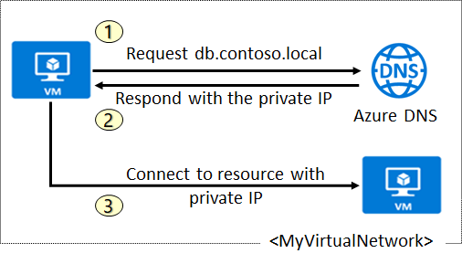
Plan for Private DNS Zones
Use your own custom domain names
Provides name resolution for VMs within a VNet and between VNets
db.contoso.lab
Automatic hostname record management
Removes the need for custom DNS solutions
Use all common DNS records types
Available in all Azure regions
Notes:
QuickStart: Create an Azure private DNS zone using the Azure portal - https://docs.microsoft.com/azure/dns/private-dns-getstarted-portal

Slide 33
Determine Private Zone Scenarios
Query:VM2.contoso.lab
Response:VM1.contoso.lab
DNS resolution in VNet1 is private and not accessible from the Internet
DNS queries across the virtual networks are resolved
Reverse DNS queries are scoped to the same virtual network

